Slide 1
Computer Architecture & Networks
CHAPTER 1(a):
Machine Level Representation of Data

Slide 2
Learning Outcomes
This chapter discusses the computer architecture concept in general;
and
the machine level representation of data, bit, bytes and words.

Slide 3
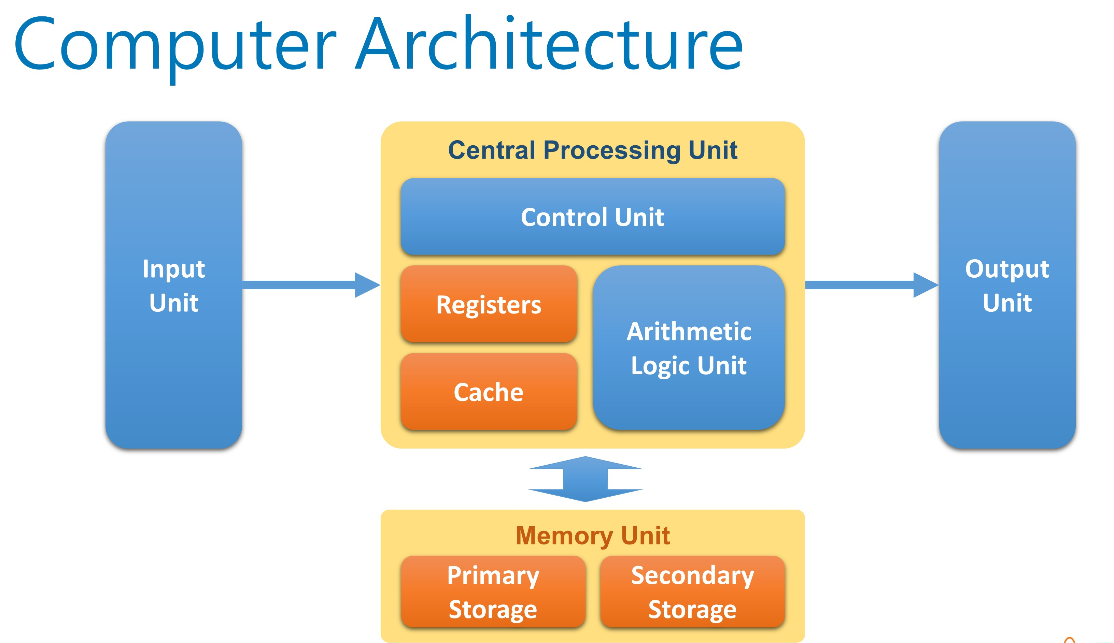
What is Computer Architecture?
Computer architecture is a set of rules and methods that describe the functionality, organization, and implementation of computer systems.
Computer architectures represent the means of interconnectivity for a computer's hardware components as well as the mode of data transfer and processing exhibited.
Different computer architecture configurations have been developed to speed up the movement of data, allowing for increased data processing.
The basic architecture has the CPU at the core with a main memory and input/output system

Slide 4
Computer System
Computers have 2 kinds of components:
Hardware consisting of its physical devices
(CPU, memory, bus, storage devices, …)
Software consisting of the programs it has
(Operating system, applications, utilizes, …)

Slide 5
Data Processing Cycle
It describes the procedures that a computer performs to process data into information
Input – data entered through input devices
Process – operations or computations performed on the input
Output – results of processed input
Storage – a place to hold the data / information for future use

Slide 6
Data Representation
Data refers to the symbols that represent people, events, things, and ideas. Data can be a name, a number, the colors in a photograph, or the notes in a musical composition.
Data Representation refers to the form in which data is stored, processed, and transmitted.
Devices such as smartphones, iPods, and computers store data in digital formats that can be handled by electronic circuitry.
In computer, data are stored in Registers.
Registers are limited in number & size.

Slide 7
DATA REPRESENTATION
Qualitative
Represents quality or characteristics
Not proportional to a value
Quantitative
Quantifiable
Proportional to value a
Name, Address
No of students, marks, CGPA

Slide 8
DATA REPRESENTATION
Data
Quantitative
Qualitative
Integers
Non-integers
Signed
Unsigned
Signed
Unsigned

Slide 9
Data Representation
Digitization is the process of converting information, such as text, numbers, photo, or music, into digital data that can be manipulated by electronic devices.
The Digital Revolution has evolved through four phases, beginning with big, expensive, standalone computers, and progressing to today’s digital world in which small, inexpensive digital devices are everywhere.

Slide 10
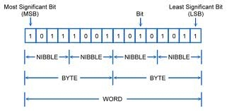
Data Representation
The 0’s and 1’s used to represent digital data are referred to as binary digits. From this term we get the word bit that stands for binary digit.
A bit is a 0 or 1 used in the digital representation of data.
A digital file, usually referred to simply as a file, is a named collection of data that exits on a storage medium, such as a hard disk, cloud, memory, or flash drive.
Byte is a unit of digital information that most commonly consists of eight bits.
Four bytes constitute a word = 32 bits

Slide 11
RECAP
What are the basic components in computer architecture?
Give 2 examples or hardware and software
What are the procedures that a computer performs to process data into information
What is data?
What is data representation?
What are the example of qualitative data?
What are the example of quantitative data?
What is bit stand for?
How many bit in 1 byte?
How many byte in 1 word?
How many bit in 1 word?

